Slide 1
Breaking down the coffee bean
Ashish Sharma

Slide 2
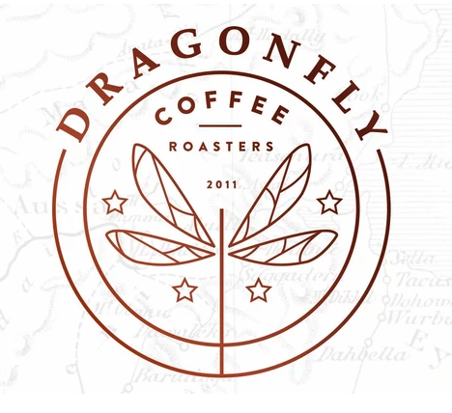
Introduction
3,614 coffee products
Across 6 roast types
31 Countries
828 Roasters
Representing 111 regions
~485 from the US
Price ranging from ~$3 to ~$200
For 12 oz of ground beans. Dragonfly Coffee Roasters based in Boulder, Colorado sells its Lotus coffee for $217 per 12 oz
Review scores ranging from 63 to 98
With ~3000 coffees rated above 90

Slide 3
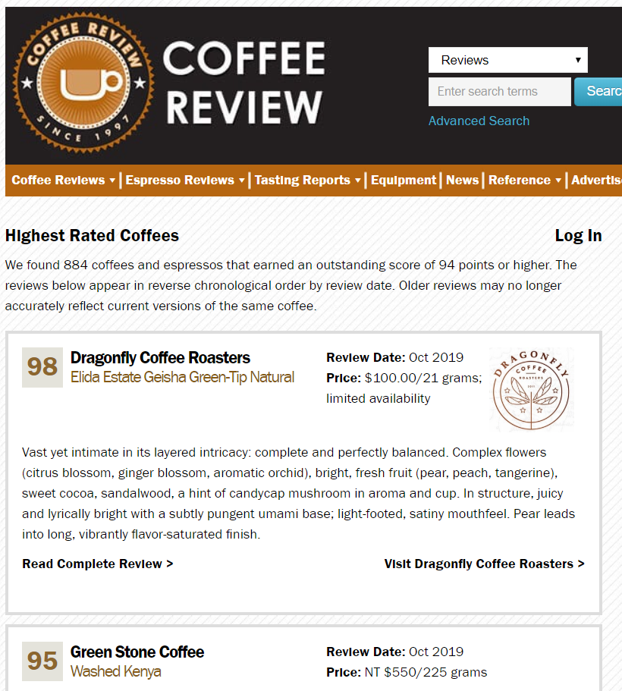
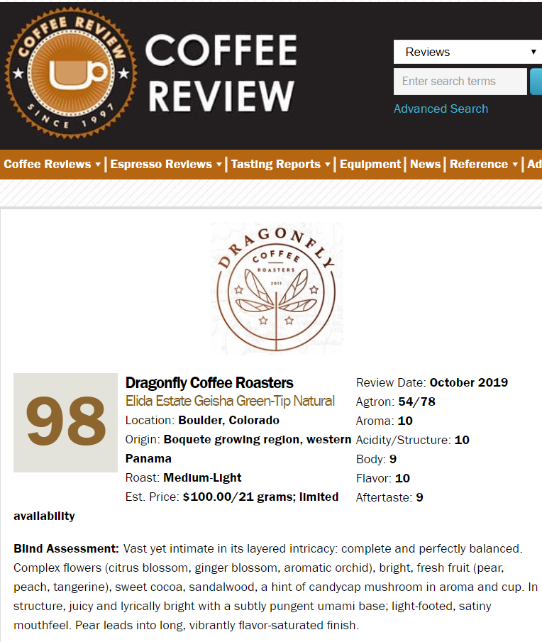
Scrapy: coffeereview.com
Source: coffeereview.com

Slide 4
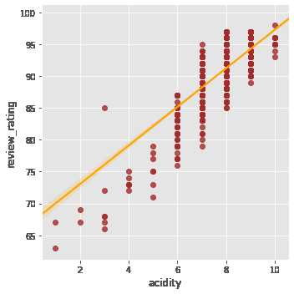
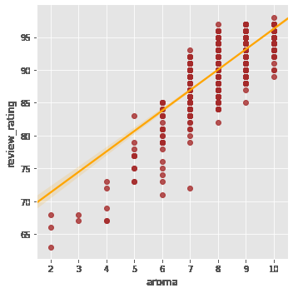
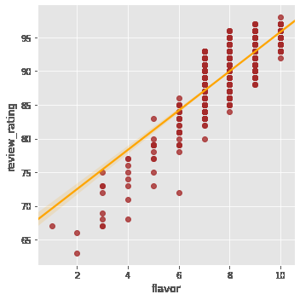
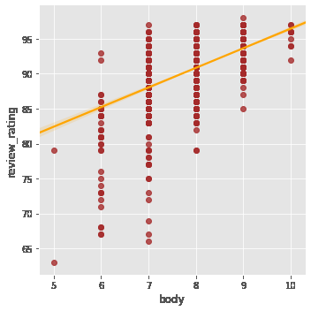
Correlations: Rating and coffee characteristics
Acidity: 0.802
the pleasant tartness of a fine coffee
Aroma: 0.784
fragrance produced by hot, freshly brewed coffee
Flavor: 0.805
what distinguishes the sensory experience of coffee once its acidity, body, and aroma have been described
Body: 0.634
the sensation of heaviness, richness, or thickness and associated texture when one tastes coffee

Slide 5
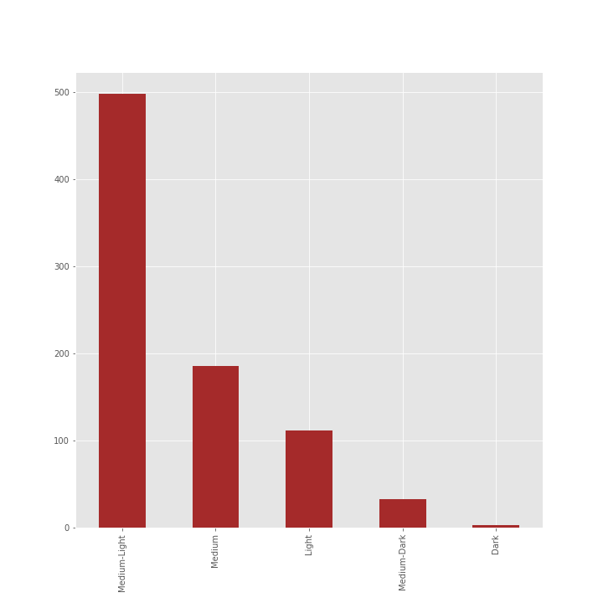
Roast Concentration
of top-rated coffees
60%
Medium-Light
22%
Medium
13%
Light
4%
Medium-Dark
1%
Dark

Slide 6
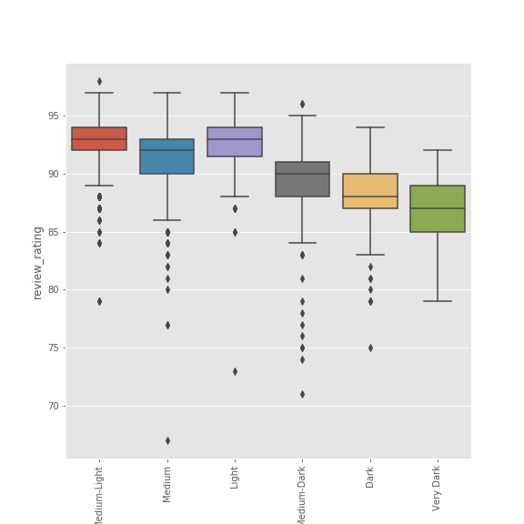
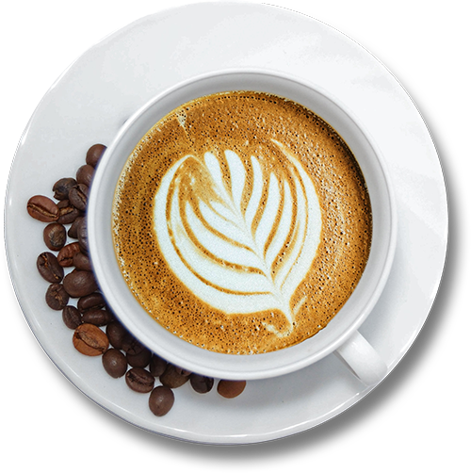
Ratings across coffee roast types

Slide 7
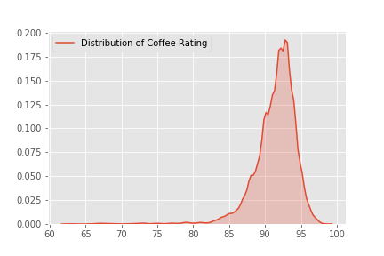
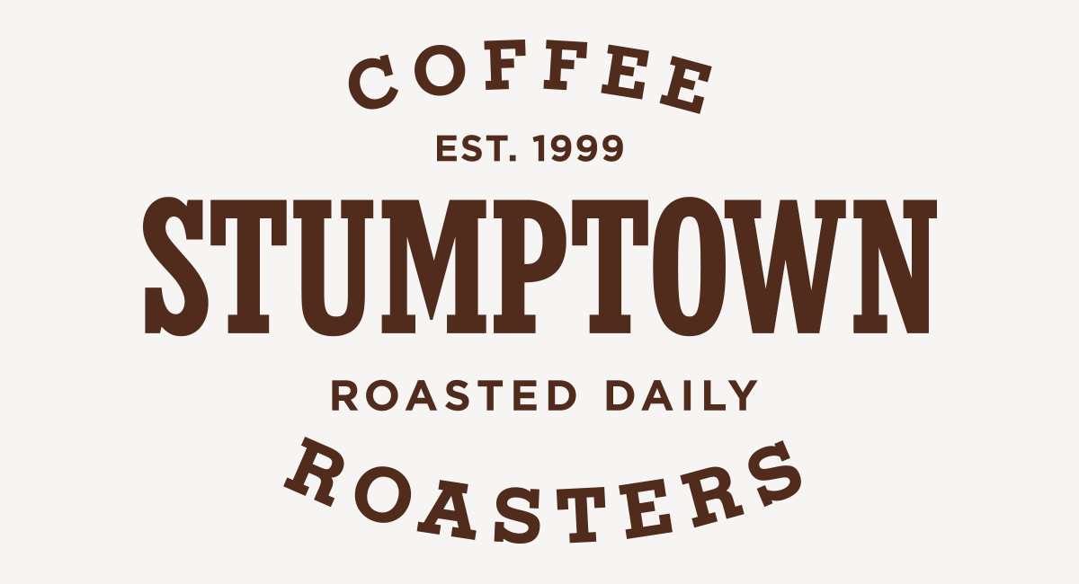
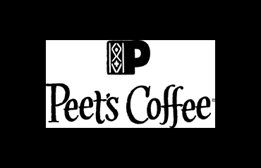
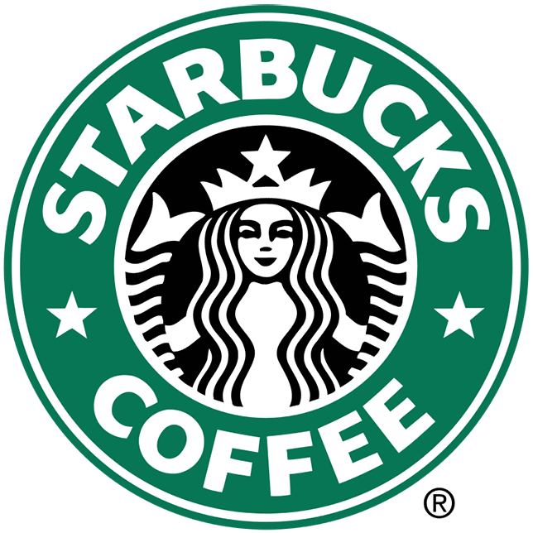
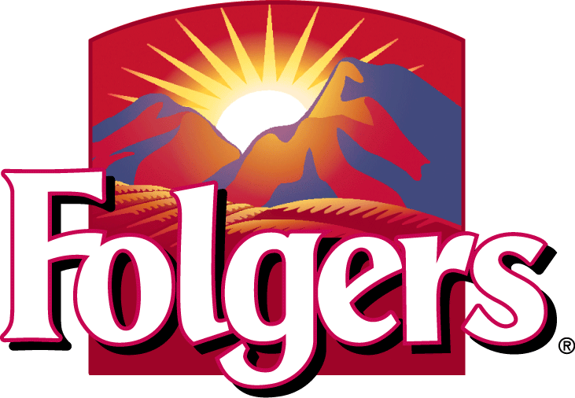
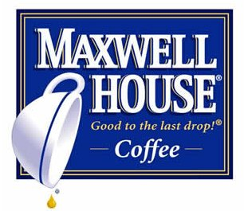
Review Score Concentration
Some of our household brands on the review spectrum

Slide 8
What’s your cup of tea?

